Slide 1
Fingerprint-based examination hall authentication system
authentication as establishing whether a candidate is who he/she says he/she is in an exam hall using their fingerprints.

Slide 2
INTRODUCTION
Examinations are critical in current education system hence they attract malpractices.
Amongst them is candidates hiring someone to sit for their exams.
Usually authentication is done using something material that a candidate holds. Examples like examination cards, student identity cards, national identity cards etc. These have demerits:
They can be transferred from one person to an impostor.
They can be misplaced or lost.
Examination cards can be faked.
Human reading of details is inefficient as it’s prone to fatigue.
Fingerprint based authentication is better as it overcomes the fore mentioned demerits.

Slide 3
LITERATURE REVIEW
Fingerprint sensor technology.
LCD display technology.
Atmega 328 P microcontroller.
Communication Protocols.

Slide 4
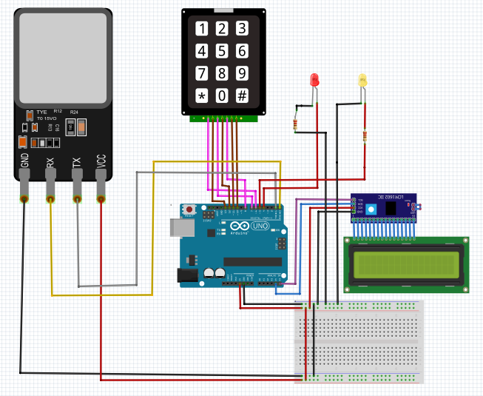
METHODOLOGY/DESIGN

Slide 5
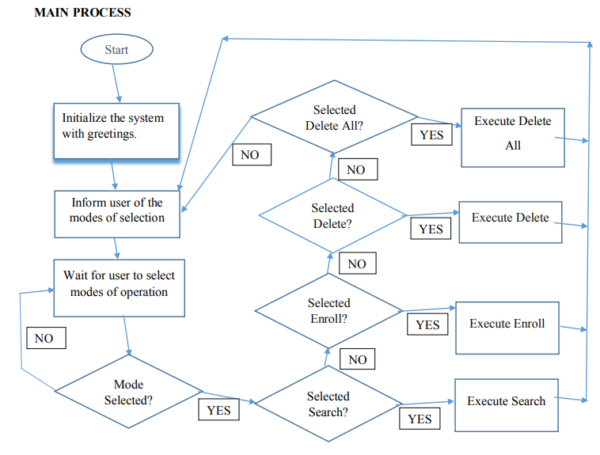
Program Flowchart

Slide 6
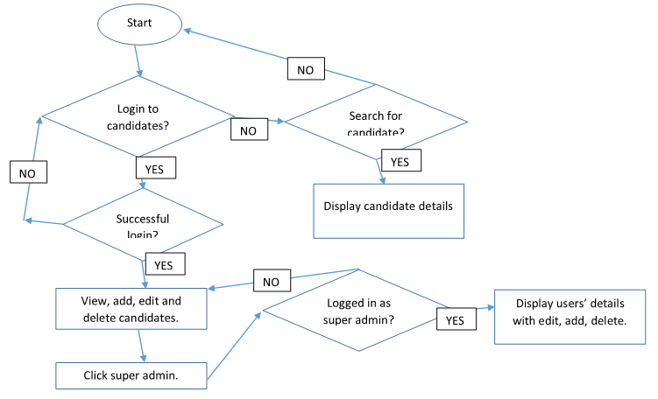
Online System

Slide 7
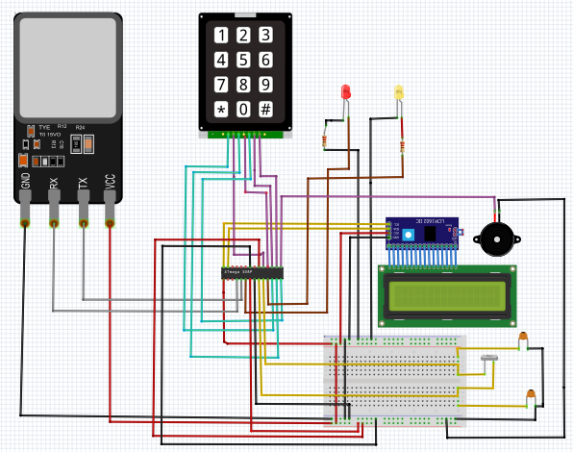
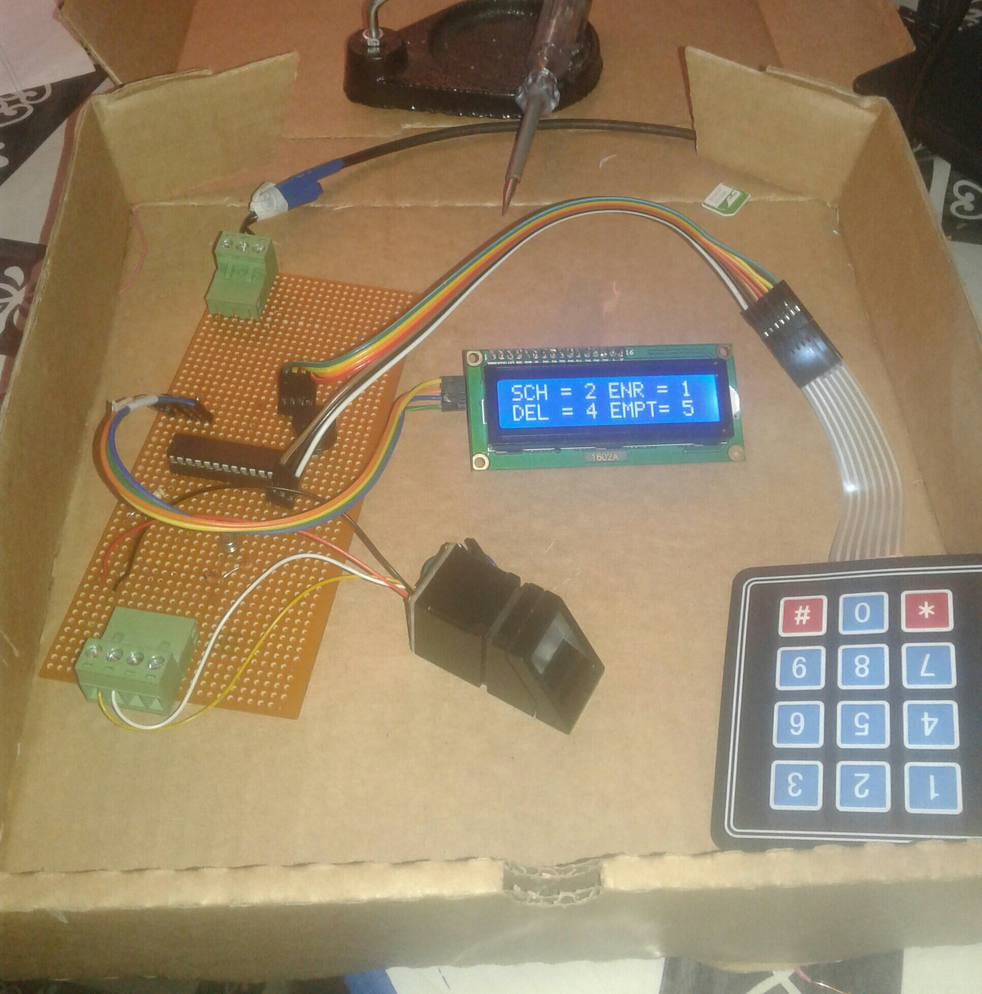
IMPLEMENTATION

Slide 8
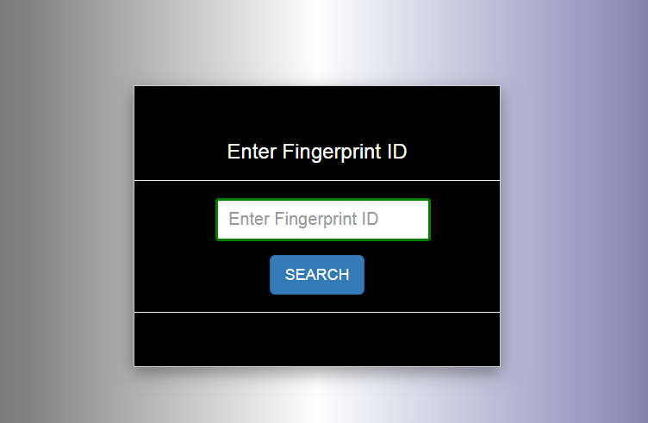
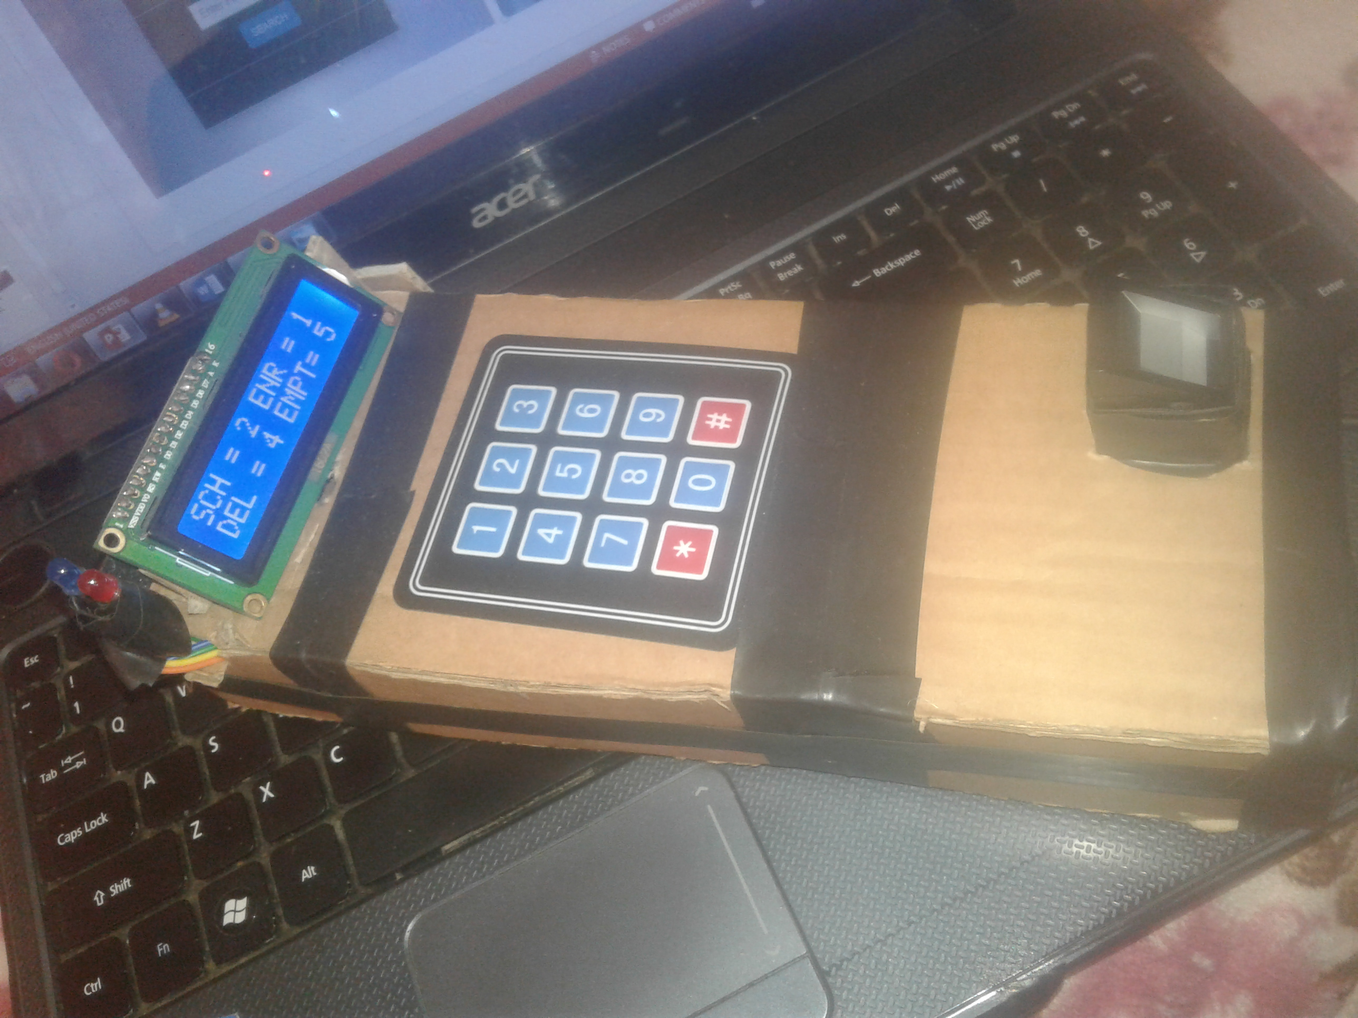
RESULTS

Slide 9
CONCLUSION AND RECOMENDATION
Enrollment, searching, deletion and emptying prints from the scanner were tested and successfully achieved.
The optical scanner is less efficient. FRR too high. Affected by lighting.
Use of better scanners with lower FRR, with higher capacity for prints to allow scalability.
Most of these scanners are more costly and they are designed to work with CISC microprocessor architecture like pc computers hence higher cost.
The system can be used by learning institutions. The system can also be used in other applications that require establishing of identities.

